Slide 1


Slide 2
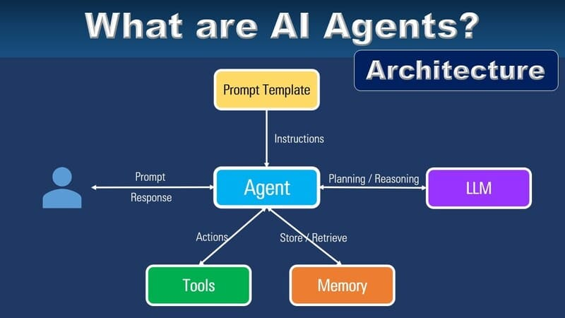

Slide 3
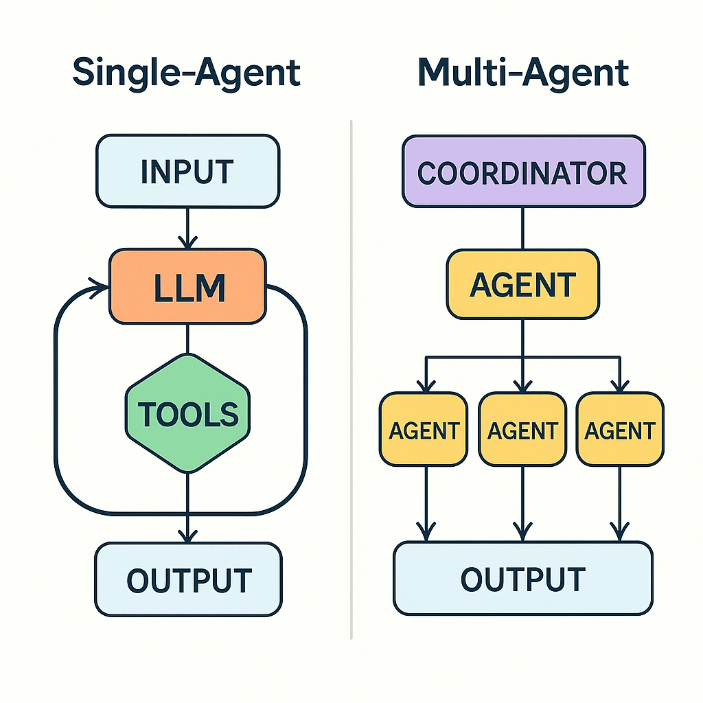

Slide 4
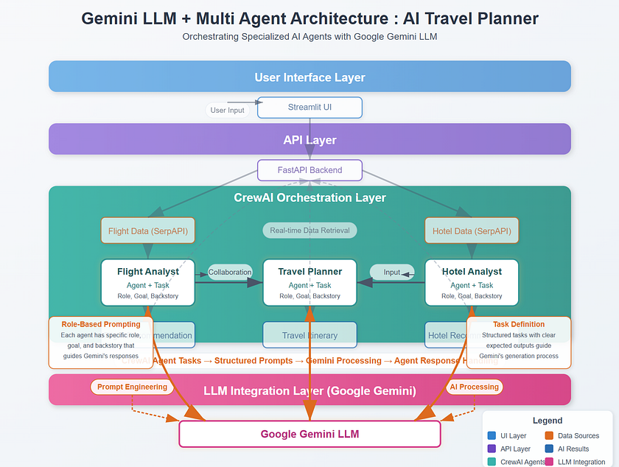

Slide 5
AI Travel Planner
Weather Agent
Flight Agent
Hotel Agent
Summary Agent

Slide 6
✈️ A flight booking agent that finds the best deals
🏨 A hotel finder that matches your preferences
📋 An itinerary builder that creates day-by-day plans
🔄 Weather Agents that executes when needed

Slide 7
